Slide 1


ECEN 403 Midterm Presentation
Solar Home Lighting 3: Jack Holdridge
Kyle Walcher
Matthew Greer
Adam Garcia
TA: Hailey Ward
Sponsor: Won Jang

Slide 2
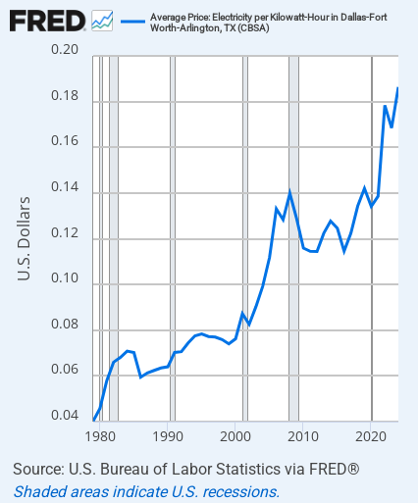
Project Summary
Problem statement:
Rising electricity demand is increasing household utility cost while grid dependence leaves homeowners exposed to outages and price fluctuations.
Our Solution:
Provides reliable illumination and security through renewable solar energy
Reduces reliance on grid and lowers monthly utility bill

Slide 3
System Overview
Adam Garcia
Kyle Walcher
Solar panel
MPPT charge controller
IOS Application
(SwiftUI)
3.3v Buck Converteri
12v deep cycle battery
ESP32-EYE
OpenAI
Jack Holdridge
12v Buck Boost DC converter
Matthew Greer
3.3v Buck Converter
Touch screen HMI
ESP32
Database
ESP32/Firmware
Relay board and LED Lights
Sensors
Notes:
Cloud server and database

Slide 4
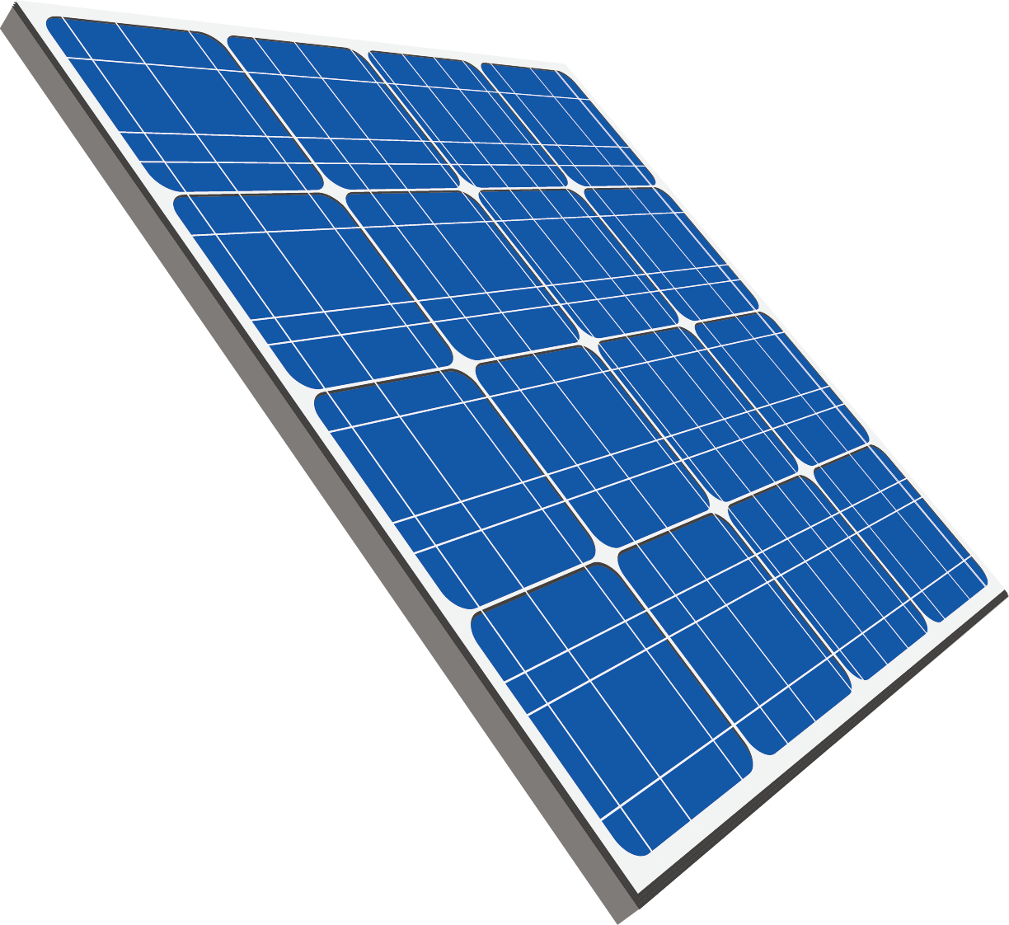
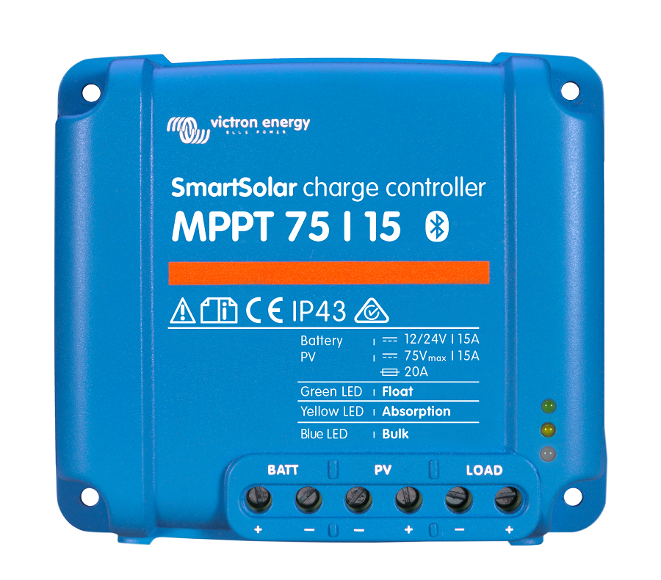
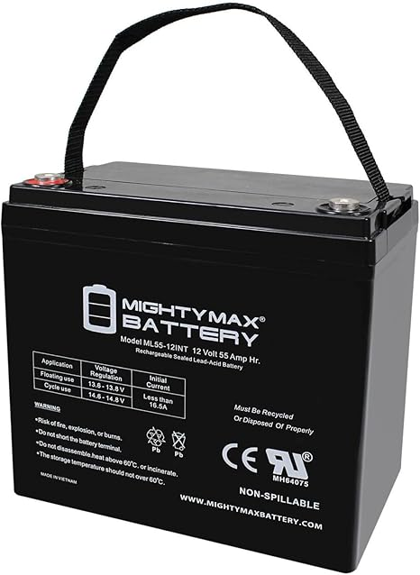
MPPT Charge Controller – Adam Garcia
Load/MMCU
Purpose:
Regulates the variable DC output from the solar panel to charge the battery.
Design:
Regulates power from the solar panel to the battery by continuously adjusting the operating point to maximize energy efficiency with PWM buck converter.
Implemented on an ESP32.
Key components:
Buck converter, current/voltage sensors, and high-speed switching elements.
Interfaces with the solar panel subsystem via analog sensing lines, communicates with the battery management system over UART, and shares status/control data with the central app interface through the Main MCU bus.

Slide 5
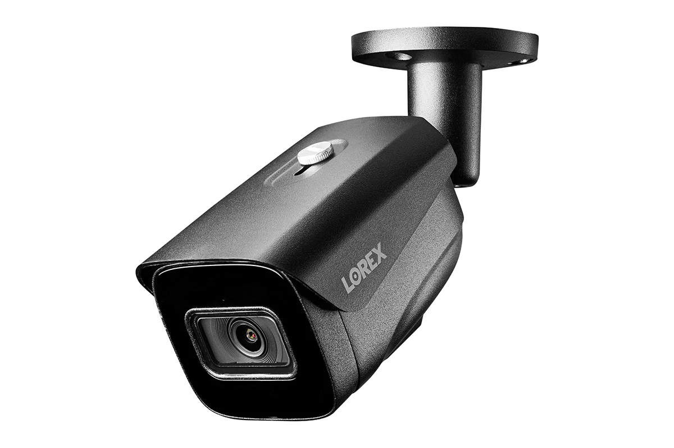
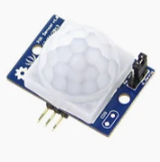
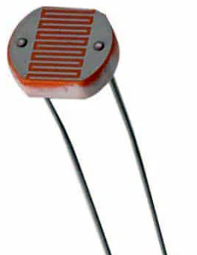
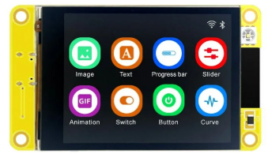
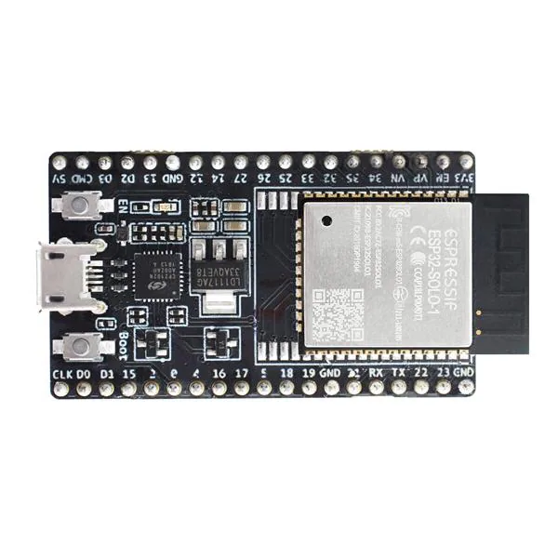
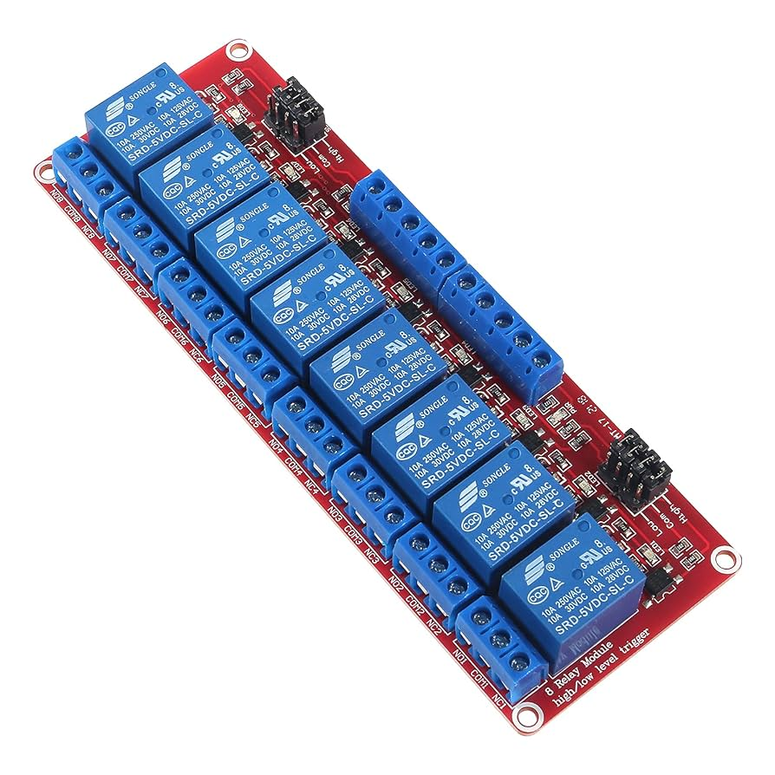
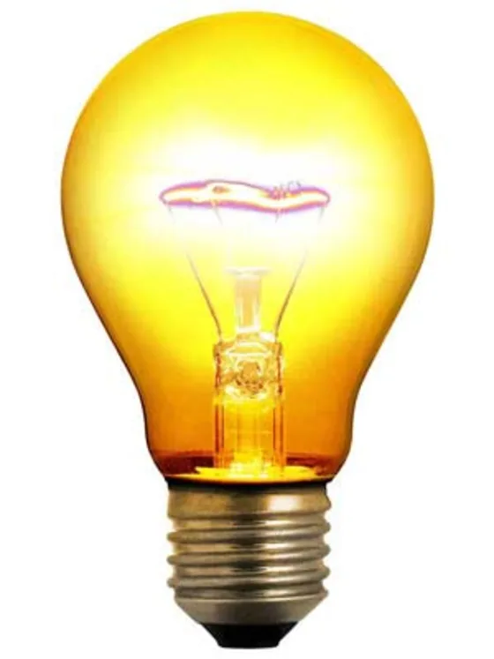
Physical Controls – Jack Holdridge
Role of Subsystem
Provides touch screen HMI for lighting
control
Displays system power level
Host DC voltage conversion for microcontroller, sensors, and lighting power
PCB serves as connection hub for other subsystems
Key Objectives and Constraints
Reliable DC conversion and distribution with minimal power loss
Compact and modular form factor to allow for easy installation
NEC design considerations to ensure safe functionality

Slide 6
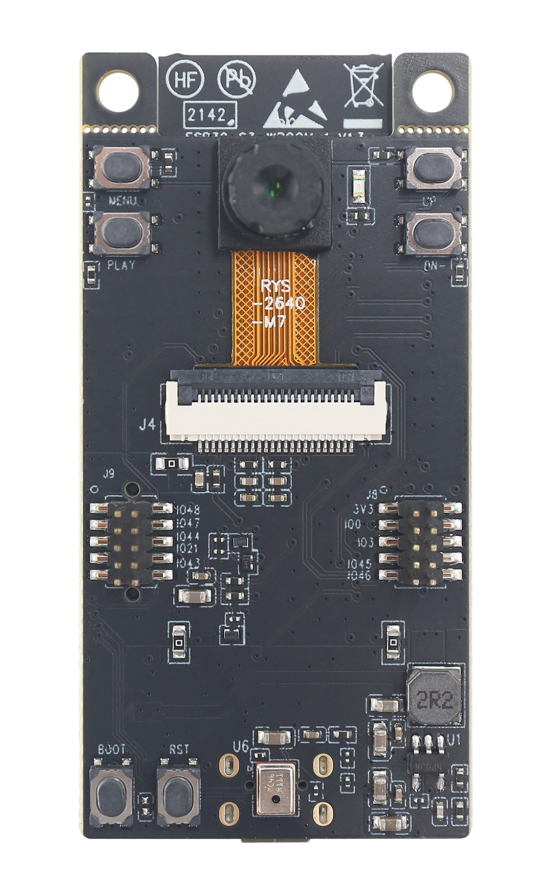


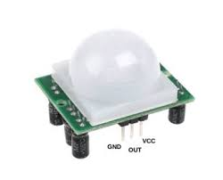

IOS Application and Camera – Kyle Walcher
Purpose
Live video monitoring with motion AI alerts and light control
Secure app integration for database logging and notifications
Design
ESP32-EYE streams camera feed to iOS app (SwiftUI)
Database (Firebase) stores and logs snapshots for later review
OpenAI for intelligent event analysis
Key Components
ESP32-EYE
SwiftUI Application
OpenAI API
Framework | Pros | Cons
SwiftUI | Good MJPEG | iOS Only
React Native | Cross Platform | High latency
Flutter | UI Widgets | Poor stream

Slide 7
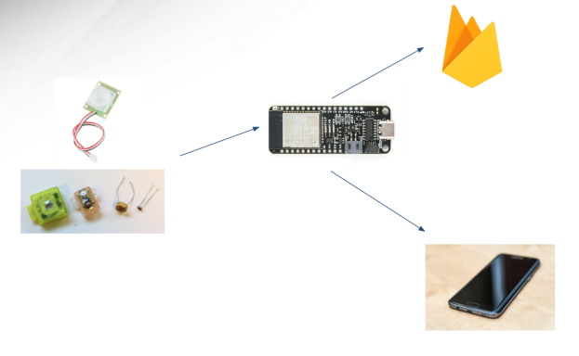
MCU/Sensors & Database – Matthew Greer
Objective: Collect sensor inputs,execute control logic and enable real time communication with mobile app and database via WiFi.
MCU/Sensors
Reads digital and analog signals to run control logic lighting
Implemented on an ESP32 using ESP-IDF(C) for greater control and efficiency
Collects data from charge controller and logs readings/events to database
Database
Stores MCU data and provides trends and alerts to be sent to the app
Built on a lightweight cloud database (Firebase)
interacts with the IOS app by sending real time data and updates
Option | Pros | Cons | Reasoning
ESP-IDF (C) | Full control, and many libraries available | Steeper Learning Curves | Scalable and professional
Arduino IDE | Easy to use, fast for prototyping | Less Control | Good for prototyping
MicroPython | Simple syntax and familiarity with Python | Uses more resources | Not suitable for real time control
Notes:
What does the subsystem do?
Collects sensor input, executes control logic and provides communication to mobile application and database via wifi
How is it being designed
Being implemented using an ESP32 MCU and programmed in the ESP-IDF environment. The Sensors being used are blank and the database platform being used is blank
Key objectives, constraints, metrics (from FSR)
Objective: Ensure reliable data collection from sensors, execute control logic and maintain real-time communication with mobile app and database
Constraints: Must operate in low power to ensure optimal battery life, limited MCU memory, dependent on Wi-Fi availability for communication with database and app
Metrics: Accuracy of sensor data, communication latency, low power consumption and reliability
How will it connect to and interact with other subsystems (from ICD)
Physical Controls: receives regulated DC power, exchanges data and sends/receives I/O signals for lighting control
Charge Controllers: Reads battery/solar status for logging and uses charge data for inputs into logic
AI Camera+iOS App: Provides real-time data and trends to the app/database and receives commands over Wi-Fi from app
If you have picked SW language, parts, show a tradeoff table that led you to that decision

Slide 8
Project Execution & Validation
 | 8/25 - today | 10/6 | 10/20 | 11/3 | 11/17
Charge Controller (Adam Garcia) | Researched components for MPPT | Design and simulate MPPT circuit, PCB, and other components | Test converters and MCU program | Circuit PCB, MCU and integrate physical controls | Validate that the battery and loads are safely powered.
Physical Controls (Jack Holdridge) | Designed system layout and functionality. | Design DC converters, touchscreen connection, and PCB layout. | Receive circuit components, and program touch screen interface. | Assemble PCB and connect sensors, load, and HMI. | Validate that the assembled HMI functions as expected.
IOS Application and Camera (Kyle Welcher) | Installed Swift UI. Developing Prototype UI | Test connection between ESP32-EYE and application | Camera fully embedded with polished UI application | Test functionality with OpenAI + weather data | Validate application communicates seamlessly with camera and database
MCU, Database, and Sensors (Matthew Greer) | Installed ESP-IDF, created database and establish base firmware framework. | Begin coding, implement initial control logic and perform calibration test. | Implement MCU to Firebase communication and validate all sensors. | Full integration test from sensors through MCU to database and app including power consumption checks | Validate communication and finalize subsystem and confirm all control logic functions as expected

